Slide 1



Indy Bekerie
Annabelle Chu
Leeanna Hyacinth
Min Ye Shen
Kiet Vo
BME Senior Design 2011-2012
Modular Incubation System
Delivering infants a better start
|
P: 212.854.6196 F: 212.854.8725
351 Engineering Terrace
1210 Amsterdam Ave
New York, NY 10027
Incuvive.weebly.com

Slide 2


Infant Health
Annual estimated proportions of death by cause for neonates Uganda, 2000
Worldwide
38% of all under-5-year-old deaths occurred in the neonatal period (2001) [1]
      99% occurred in the developing countries
      ¾ of neonatal deaths occurred during the 1st week of life
      24-45% of neonatal deaths occur during the 1st 24 hrs.
Uganda
Infant mortality rate 80/1000 live births (2009) [2]
      Ranked 177 of 224 countries [3]
      United States: 7/1000
    Neonatal mortality rate 30/1000 (2009)
      United States: 4/1000
    Health expenditure per capita (2006)[4]
      Uganda: $71
      United States: $6,719
Causes | Deaths (%) | Regional average (%)
Total neonatal deaths | 100 | 100
Neonatal tetanus | 5 | 9
Severe infection | 26 | 27
Birth asphyxia | 27 | 24
Diarrheal diseases | 2 | 3
Congenital anomalies | 7 | 6
Preterm birth | 25 | 23
Others | 8 | 7
Deaths from hypothermia is often masked under other causes
World Health Organization. Estimates. In: State of the world's newborns. Washington: Saving Newborn Lives, Save the Children/USA; 2001: PN1–49.
Infant mortality rate, Uganda. Google.com/publicdata
Cia World Factbook, 2009. http://www.cia.gov.
Uganda. World Health Organization. 2006. www.who.int
P: 212.854.6196 F: 212.854.8725
351 Engineering Terrace
1210 Amsterdam Ave
New York, NY 10027
|
Incuvive.weebly.com
Notes:
[1] World Health Organization. Estimates. In: State of the world's newborns. Washington: Saving Newborn Lives, Save the Children/USA; 2001: PN1–49.
[2] Google.com/publicdata
[3] Cia World Factbook 2009

Slide 3
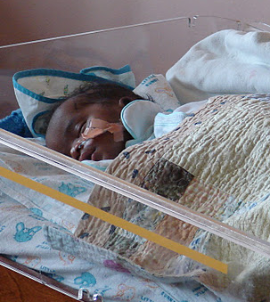
Hypothermia: Definition and Causes
Normal temperature of newborn 36.5-37.5 °C
Temperatures < 35 °C is “under temperature” → hypothermic
      Indicates either surrounding is too cold or infection
    Infant body acts as a heat sink [5]:
      Poor thermal insulation
      Large SA:V
      Small mass
      Heat loss via conduction, radiation, convection, and evaporation
      Preterm infants are at highest risk of hypothermia
    Those that survive often face [6]:
      Diabetes
      Heart disease
      Low IQ
      Other complications
5. Kawaji, Q. An alternative infant incubator: incubators for third world countries. Johns Hopkins University. https://jscholarship.library.jhu.edu.
6. Why embrace. Embrace. http://www.embraceglobal.org.
Notes:
[4] Kawaji, Q. An alternative infant incubator: incubators for third world countries. Johns Hopkins University. https://jscholarship.library.jhu.edu
[5] http://embraceglobal.org/main/why

Slide 4
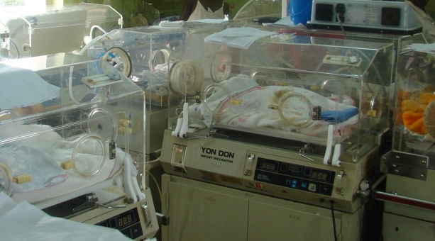
Mulago Hospital, Kampala, Uganda
    Uganda’s largest regional hospital
    Neonatal intensive care unit (NICU) cares for 56 babies on a light day
      Roughly 60% are born premature
      3 nurses (2 at night) to split between two 20’x35’ rooms
    Incubators exist but are nonfunctional
      Over 95% of medical equipment in public hospitals are imported [6]
        96% of foreign donated equipment do not work 5 years after donation
      The most common part that breaks down is the thermostat
    There is a need for a modular incubator system
      To revive current nonfunctional incubators
      To convert available cribs to modest incubators
P: 212.854.6196 F: 212.854.8725
351 Engineering Terrace
1210 Amsterdam Ave
New York, NY 10027
|
Incuvive.weebly.com

Slide 5

We propose to develop a low-cost, portable, easy to use, and easy to maintain modular system that provides a warm, humid, and safe environment for at-risk infants.

Slide 6
Functional Requirements and Constraints
Functional Requirements:
Maintain a temperature range
  35-37 ºC
Monitor infant temperature
Ventilation
Humidification
  40-80% relative humidity
Constraints:
Affordable
Durable
Easy to maintain and repair
Portable
Biocompatible and comfortable
Intuitive and easy to use
Useable in a variety of incubators and cribs
Low powered
Easy to sterilize and clean
Allow for high infant visibility
http://

Slide 7
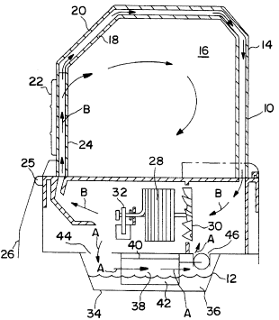
Functional Requirements and Constraints
http://
28 - Conventional heater
30 - Fan
32 - Electric motor
34 - Reservoir of water
40 - Strip heater
42 - Heat exchanger
Jones T, Belsinger H, Mackin M, inventors; 1996 Jul.23.Heat controlled humidifier for infant incubator. United States patent US 5,539,854.

Slide 8
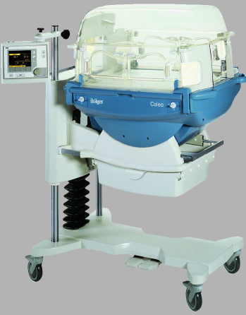
Caleo Neonatal Incubator
  Provides a controlled warm, humid, and oxygen-enriched environment
  Monitors and controls air temperature, skin temperature, humidity, oxygen concentration, and weight
  Pros:
  Intuitive and easy to use
  High infant visibility
  Monitors and alarms
  Rechargeable battery
  Cons:
Bulky and expensive
Requires trained technician to repair
Parts not widely available
Caleo Neonatal Incubator, Drager Medical. http://clinicalengineering.duhs.duke.edu/wysiwyg/downloads/caleo.pdf
P: 212.854.6196 F: 212.854.8725
351 Engineering Terrace
1210 Amsterdam Ave
New York, NY 10027
|
Incuvive.weebly.com

Slide 9
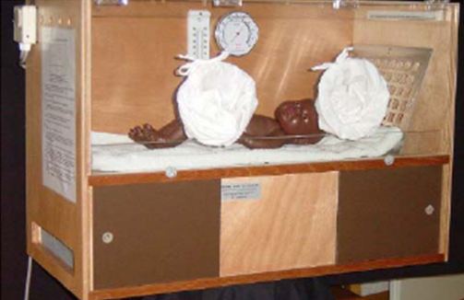
VAN HEMEL Baby Incubator
  Built specifically for the developing world
  Uses light bulbs and the chimney principle to heat and humidify
  Has an on/off switch for lights, a thermometer, and a hydrometer
  Pros:
  Cheap (~$500)
  Made with highly available materials
  High infant visibility
  Cons:
Not portable
Bulky
Does not have fine temperature control
Only monitors ambient temperature
Must be shipped from Amsterdam
HEBI Hemel Baby Incubator.
http://www.hebi-incubator.org/templates/heb/global/index.php?lngid=2&sqlmode=1&fid=144

Slide 10
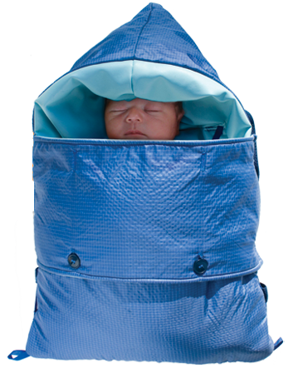
Embrace Warmer
  An infant warmer designed for neonatal transport in the developing world
  Uses a phase change material to warm the child
  Pros:
  Cheap
  Portable
  Cons:
Warming only
No temperature monitoring
Low infant visibility
Need to refresh phase change material every 4 hours
Embrace. http://embraceglobal.org/

Slide 11
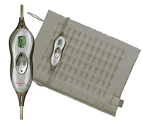
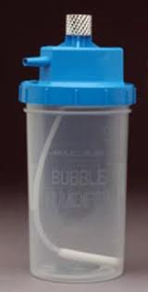
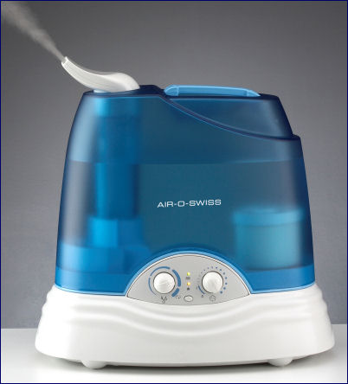
Concept Selection
http://www.alphamedsupply.com/product_images/i/817/A-5701__26125_thumb.jpg
  Ventilation
    Fan
    Simple vents
  Humidification
    Wick humidifier
    Bubble humidifier
    Vaporizer
  Maintain a temperature range
    Space heater
    Phase change material
    Heating mat
  Monitor infant temperature
    Feedback system
    Sound and/or light alarm
    system
Heater
Heating Mat
Bubble Humidifier
Wick Humidifier
-Vornada <http://www.vornado.com/Home.aspx>
-Walmart, Sunbeam Health King-Size Programmable Heating Pad, <http://www.walmart.com/ip/Sunbeam-Health-King-Size-Programmable-Heating-Pad/3205707>
-Alpha Medical, Bubble Humidifier, 400 cc/ml 4PSI <http://www.alphamedsupply.com/product_images/i/817/A-5701__26125_thumb.jpg>
-Winter Skin Care Blog <http://winterskincareblog.com/wp-content/uploads/2008/05/33.jpg>

Slide 12
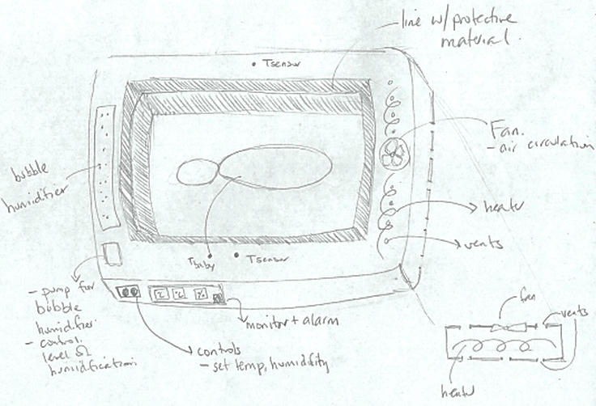
Idea #1
  Lines the perimeter of incubator
  Makes use of a heater, bubble humidifier, and a fan to accommodate functional requirements
  PROS:
  May be used in a crib with dome covering
  Comfortable
  High infant visibility
  CONS:
  Shape may need to be adjusted for each incubator unit
  Safety concern of location of heater and humidification system

Slide 13
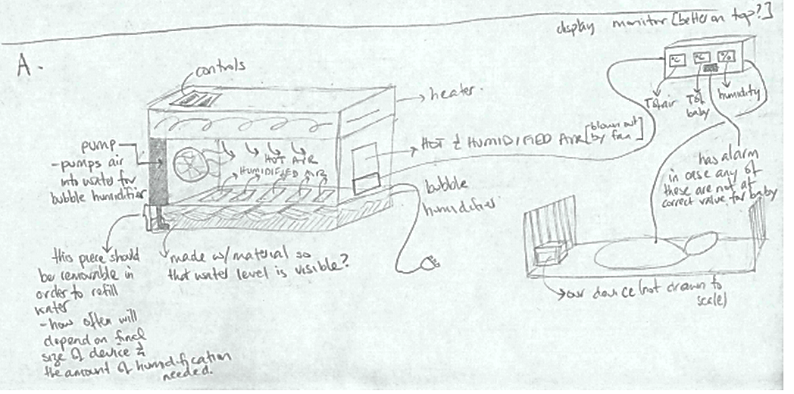
Idea #2
  Portable box that is inserted into incubator
  Makes use of a heater, bubble humidifier, and a fan to accommodate function requirements
  PROS:
  Comfortable
  High infant visibility
  Portable
  CONS:
  Safety concern of location of heater and humidification system
  May reduce space available for infant

Slide 14
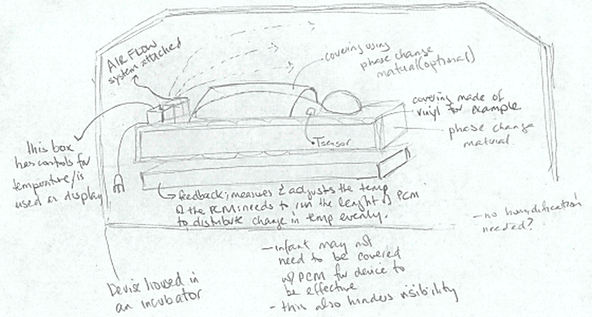
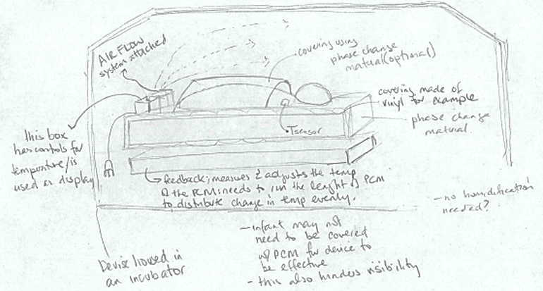
Idea #3
  Mat that can be inserted into incubator
  Makes use of phase change material and a fan.
  PROS:
  Eliminates the need for a separate humidification system
  Portable
  Prevents infant skin burns
  CONS:
  May limit infant visibility
  May require large quantities of power

Slide 15
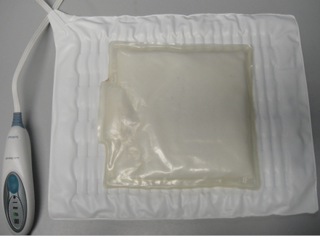
Proof of Concept
Main Functional Requirements:
Provide warmth to the baby
Test the ability of the phase change material (PCM) to maintain a constant temperature for a saline bag
  Heat the PCM (with an electric heat mat)
  Place a bag of saline on the PCM and monitor the saline’s temperature
Monitor the temperature
Test the accuracy of different temperature sensors
  Build circuitry
  Calibrate
  Correlate with the saline’s temperature being heated by PCM

Slide 16

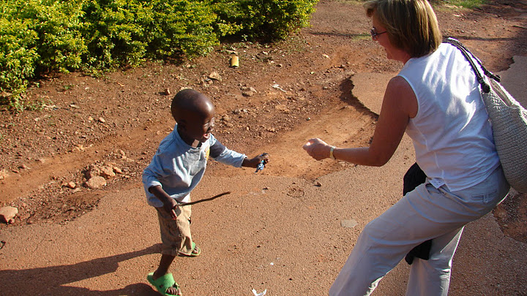

Acknowledgments
Instructors
  Dr. Elizabeth Hillman, Ph.D.
  Dr. Aaron Kyle, Ph.D.
  Mr. Keith Yeager
  Sarah De Leo (TA)
Advisers
  Dr. Lance Kam, Ph.D.
  Dr. Margaret Nakakeeto-Kijjambu, MD, Mulago Hospital
  Dr. Richard Polin, MD, CUMC Pediatrics
  Dr. Helen Towers, MD, CUMC Pediatrics
  Dr. Yvonne Vaucher, MD, UCSD
Notes:
[1] World Health Organization. Estimates. In: State of the world's newborns. Washington: Saving Newborn Lives, Save the Children/USA; 2001: PN1–49.
[2] Google.com/publicdata
[3] Cia World Factbook 2009
[4] Kawaji, Q. An alternative infant incubator: incubators for third world countries. Johns Hopkins University. https://jscholarship.library.jhu.edu
[5] http://embraceglobal.org/main/why
[6] Technologies for clinically relevant physiological measurements in developing countries
http://iopscience.iop.org/0967-3334/28/8/R01

