Slide 1
BME Senior Design 2011-2012
Frankenstein Prototype
March 8th, 2012
Indy Bekerie
Annabelle Chu
Leeanna Hyacinth
Min Ye Shen
Kiet Vo
Modular Incubation System
Delivering infants a better start
|
P: 212.854.6196 | F: 212.854.8725
351 Engineering Terrace
1210 Amsterdam Ave
New York, NY 10027
incuvive.weebly.com
Notes:
Good morning. Today IncuVive would like to present our Frankenstein Prototype of our Modular Incubation System, Delivering infants a better start. My team consists of Indy, Annabelle, Min, and Leeanna. CLICK

Slide 2
The Problem
Hypothermia causes or contributes to 18-42% of the 4 million annual infant deaths in the third world [1]
Current effective solutions do not address the needs and constraints of the third world
Societal costs
Emotional and mental distress
Financial
Per capita health expenditure in Uganda: $71
Average annual Ugandan family expenditure: $48
Potential economic contribution and production foregone [2, 3]
[1] UNICEF. Progress for children: a world fit for children statistical review. New York, NY: United Nations Children`s Fund; 2007
[2] Baird, S., et al. Aggregate income shocks and infant mortality in the developing world. July 2009.
[3] Santere, R., et al. Government intervention in health care markets and health care outcomes: some international evidence. Cato Journal. Cato Institute: 1991.
P: 212.854.6196 F: 212.854.8725
351 Engineering Terrace
1210 Amsterdam Ave
New York, NY 10027
|
Incuvive.weebly.com
Notes:
CLICK: Hypothermia causes or contributes to 720,000 to 1.68 million annual infant deaths in the third world.
CLICK: Roughly 15-18 infants die annually in Uganda from hypothermia.
However, all newborns are susceptible to hypothermia and can benefit from our technology.
CLICK: Infant hypothermia has large societal costs, including emotional and mental distress to families and friends of the victims. Infant deaths have also contributed to the rising costs of healthcare. An affordable and effective solution to infant hypothermia can lower health expenditure per capita. Furthermore, while this may not be the most pressing of issues, infant hypothermia can eliminate a victim’s future potential contributions to the economy and to society.
CLICK
[1] UNICEF. Progress for children: a world fit for children statistical review. New York, NY: United Nations Children`s Fund; 2007
[2] Baird, S., et al. Aggregate income shocks and infant mortality in the developing world. July 2009.
[3] Santere, R., et al. Government intervention in health care markets and health care outcomes: some international evidence. Cato Journal. Cato Institute: 1991.
Identifying, formulating, and solving engineering problems; understanding the impact of the design solution in a global and societal context. Understanding of underlying biology and physiology of the biomedical problem.

Slide 3
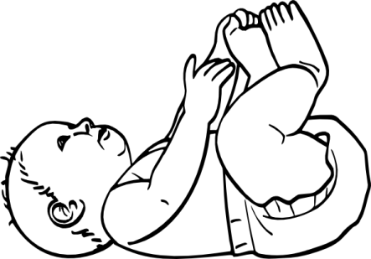
Hypothermia Physiology
Normal: 36.5 - 37.5 ⁰C
Hypothermic: < 36.5 ⁰C
Heat loss
Ineffective non-shivering thermogenesis
Reduced brown fat
Large surface area to volume ratio
Decreased thermal insulation due to less subcutaneous fat
Evaporation of amniotic fluid after birth
Conduction (by coming in contact with cold objects—e.g., cloth, tray)
Convection (by cooler air currents, open windows)
Radiation (to colder solid objects in vicinity—e.g., walls)
Without an effective intervention, hypothermia is imminent
P: 212.854.6196 F: 212.854.8725
351 Engineering Terrace
1210 Amsterdam Ave
New York, NY 10027
|
Incuvive.weebly.com
Notes:
CLICK: The normal infant range is 36.5-37.5 degrees C.
CLICK: Hypothermia occurs when the infant’s core temperature dips below 36.5 degrees C.
CLICK: Much of the heat loss occurs because of the infants inability to produce enough heat, or non-shivering thermogenesis because the infant has less brown fat. The metabolism of brown fat in various body parts produce heat. The blood circulating by is warmed and then circulated throughout body thereby warming the body.
CLICK: Heat loss is exacerbated by the infants large SA:Vol ratio and decreased thermal insulation
CLICK: Furthermore, heat loss occurs through evaporation, conduction, convection, and radiation.
Without an effective intervention, hypothermia is imminent.

Slide 4
Our Modular Incubation System is an innovative, effective, and viable solution to combat infant hypothermia in developing countries.
Functional Constraints | Kangaroo care | Incubators | Wrapping infants | Heat pad | Our Product
Affordable
Low maintenance
Practical
Effective
High controllability
High infant visibility
Safe
Notes:
Current solutions do not address all the needs of developing countries.
Kangaroo care, or skin-to-skin contact is impractical in larger settings as it requires a lot of human capital.
Incubators are too expensive and require a lot of expertise and money to maintain.
Wrapping an infant in layers only prolongs the inevitable hypothermia.
Some health settings also utilize heat pads but they may be ineffective and are limited in controllability.
CLICK: Our Modular Incubation System is affordable, practical, effective, and highly controllable as well as practical in large health care settings. With our unique product and business strategies, our product can outperform current products in the market.

Slide 5
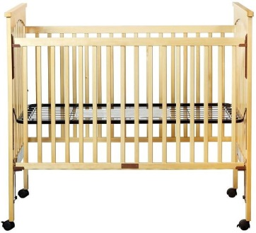
Innovation and Utility
Primary function is to warm the infant
Controlled heating designed to prevent hypothermia
Continuous monitoring of abdominal skin/armpit infant temperature
Alarm LED which signals infant overheating or fever
Allows high visibility of infants
Durable and low cost
Functions as a stand alone incubator
Can repurpose non-functioning incubators
Designed specifically to be used in low resource settings
On Own
Mat

Slide 6
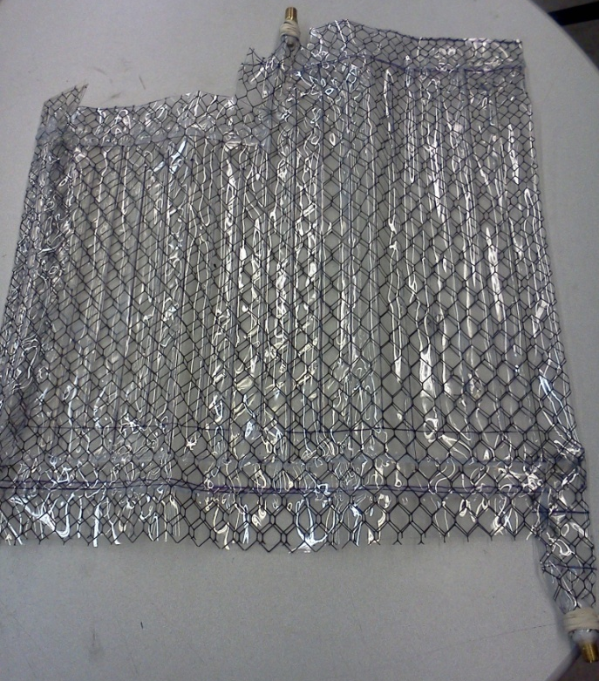
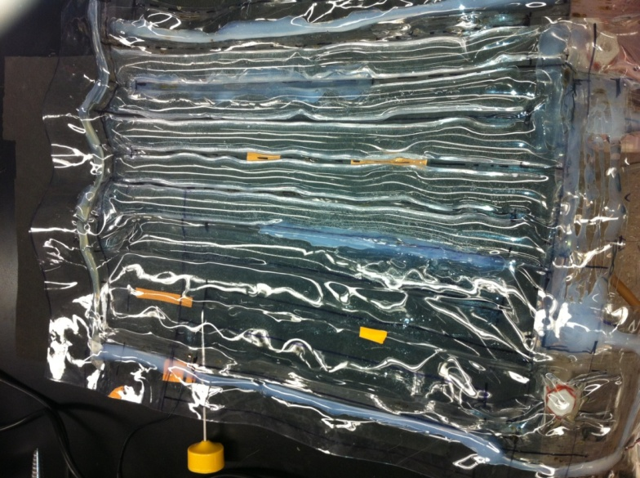
Prior Prototypes
40
Inlet
Outlet
Heat Sealed
Leakage
Inconsistent sealing
Hot Glue Sealed
Leakage
Channels failed
Notes:
Prior mat prototypes were made of two layers of PVC materials heat sealed together with open channels to allow for water circulation. However, while able to heat adequately, this method was impractical as it oftentimes created in multiple holes and leaks which resulting in hours of troubleshooting.
-reasons for heating coil specs (energy calculations)- We calculated the heat loss to be around 350-400 W but the cheapest heater with the min power rating was the 1000W.
-size of mat
-flow rate?
-why chose infant model
-address failed prototypes and transition to final prototype
Appropriateness of design that will satisfy functional requirements & constraints. Design of a system, component, or process that meets desired needs.

Slide 7
Current Prototype
Inlet Tubing
Mat
12.5 in. x 18 in.
Silicone rubber tubing
PVC square pipe
1.15 L
Bucket
13.25 L
Pump
0.21 L/s
Heating Unit
1000 W
Feedback algorithm
Raise and maintain mat surface to a specific temperature range
Digital and analog fail-safes
Mat
Outlet Tubing
Reservoir
Control Panel
Mat
Ready
LED
Heater
Mat °C
Infant °C
Pump
Infant Over Heating LED
Power
Heater LED
Notes:
--Prior mat prototypes were made of two layers of PVC materials heat sealed together with open channels to allow for water circulation. However, while able to heat adequately, this method was impractical as it oftentimes created in multiple holes and leaks which resulting in hours of troubleshooting.
--We are utilizing a 1000 W heating coil to heat a water reservoir because 1000 W was the lowest rating available and is more than enough energy to heat our infant according to our energy calculations.
--We are also using a 13.25 L water reservoir, oftentimes filling only 10 L of water for our tests. Future prototypes will be able to use any generic water reservoir/bucket.
--The mat is made of an array of silicone rubber tubes, a material that is biocompatible to prevent any discomfort.
--Our feedback algorithm raises the mat surface to a specific temperature range and maintains that range for an extended period of time
--In addition to analog fail safes, our feedback algorithm also has built in fail safes that Annabelle and Min will speak about.
--Typically, premature neonates weigh anywhere between 1.5 to 2.5 kg. Unfortunately the largest saline bags we found were 1.0 L and so we used them to model our infant, which is a good approximation of the 70% electrolyte-water mixture by mass.
-reasons for heating coil specs (energy calculations)
-size of mat
-flow rate?
-why chose infant model
-address failed prototypes and transition to final prototype
Appropriateness of design that will satisfy functional requirements & constraints. Design of a system, component, or process that meets desired needs.

Slide 8
Feedback Mechanism and Fail-Safe
T_{feedback}<T_{feedback target}
T<T_{cutoff}
T_{mat}< T_{mat cutoff}
T_{infant}<T_{overheating}
T>0 °C
Thermistors
Arduino
Manual switch
Relay
Heater
Feedback Thermistor
Comparator
Notes:
-Add Circuitry Schematic Here (lh)

Slide 9
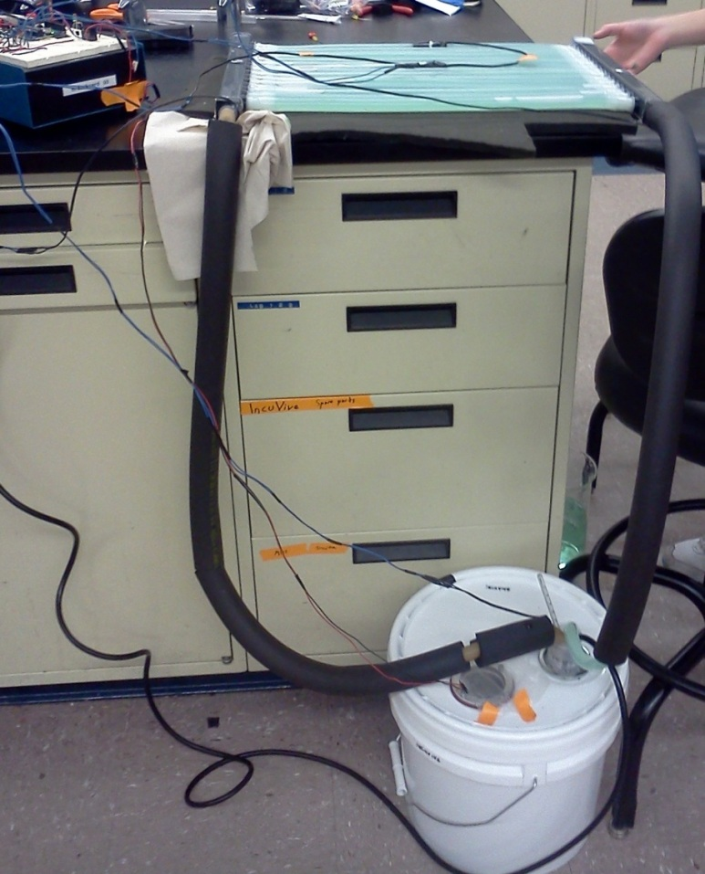
Current Prototype
Side View
Notes:
Mention the insulation around tubes and below mat

Slide 10
Current Prototype
Side View
Prototype in Action
Notes:
Mention the insulation around tubes and below mat

Slide 11
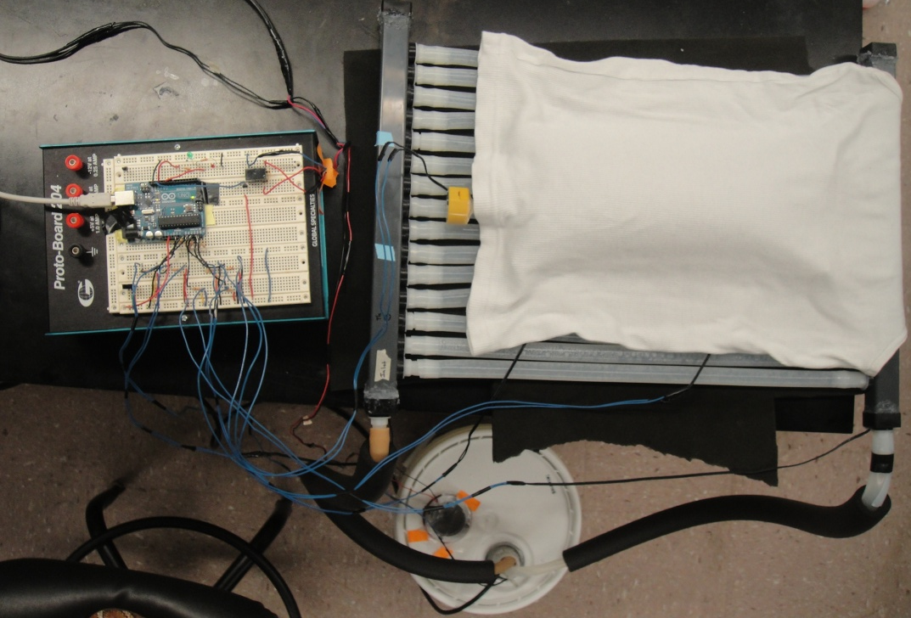
Testing Setup
Thermistors
Reservoir
Inlet
Outlet
Mat surface
Saline bag
T_{inlet} > T_{outlet} by 1.0 ±0.1 ⁰C
T_{reservoir}> T_{mat} by 1.3 ±0.5 ⁰C
Feedback System
Target temperature at 40.75±0.25 ⁰C
Mat cutoff at 40 ⁰C
Infant overheating at 38 ⁰C
General cutoff at 50 ⁰C
Inlet
Outlet

Slide 12
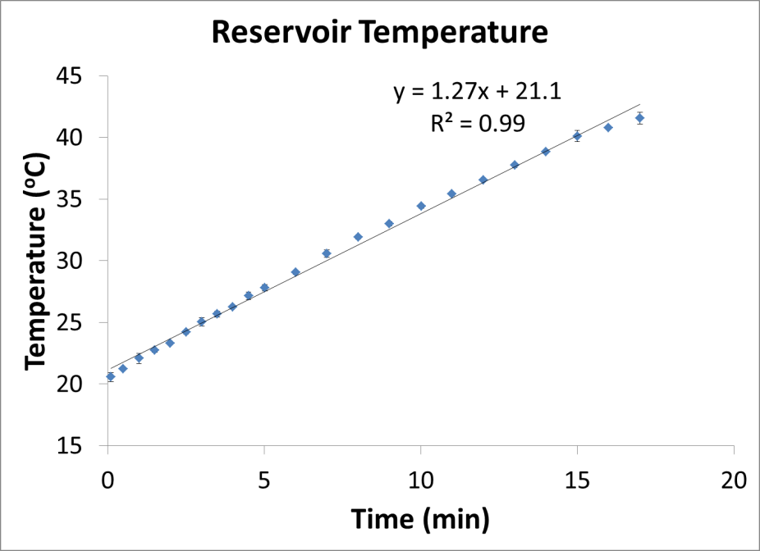
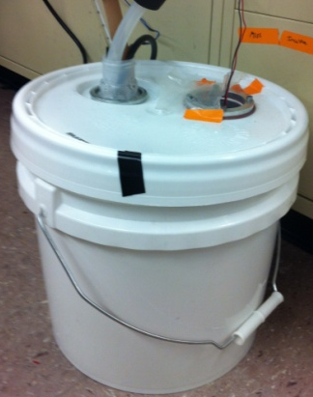
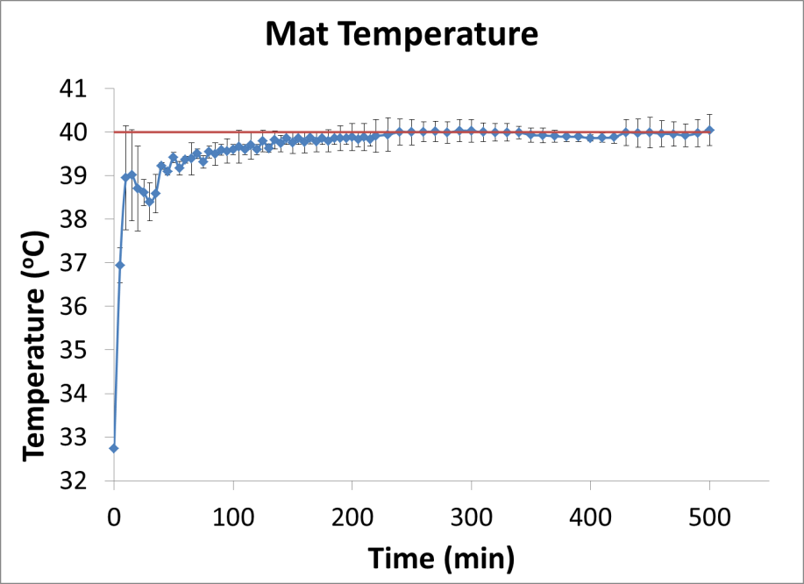
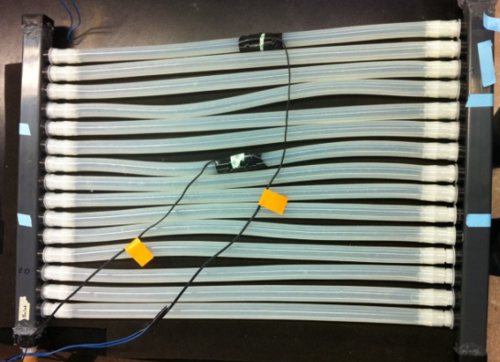
Testing Setup
Reservoir Temperature
Water (10 L) in reservoir increases by 10 ⁰C every 8 min until it reaches 41 ⁰C (user-defined)
Mat Temperature
Mat temperature maintained around 40 ⁰C
Notes:
It took an average of 8 min to raise 10 L of water in the reservoir by 10 deg C. For each trial, the water was heated from 20 deg to 41 degC in about 18 min.
We also monitored the temperature of the surface of the mat under the saline bag. We found that the mat was maintained at around 40 degC during the trials.
From our data, we also found that there was an average of 1.3degC difference between the water in the reservoir and the surface of the mat.

Slide 13
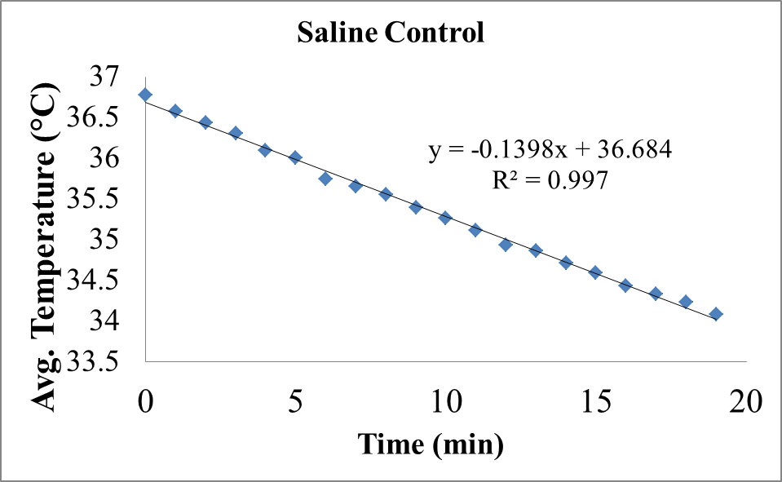
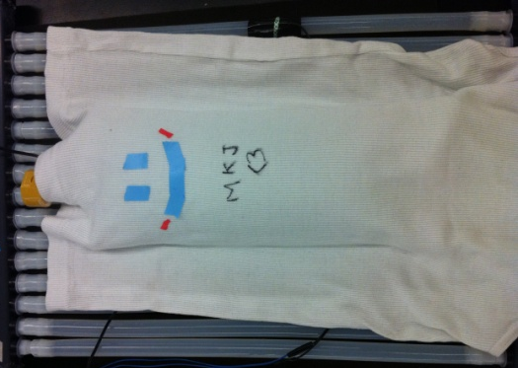
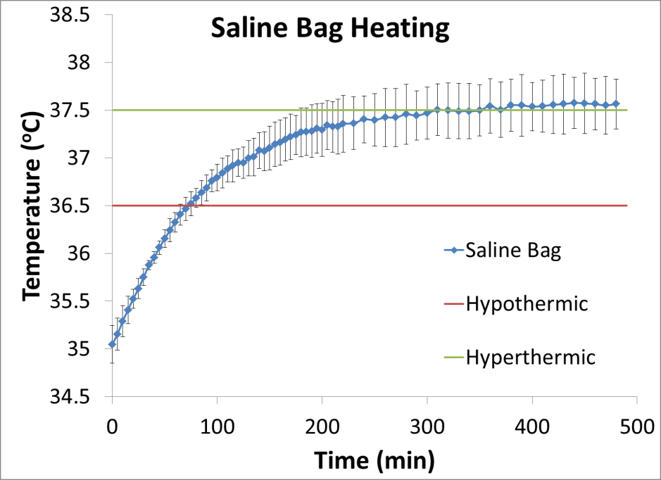
Testing Setup
Saline Bag (1L)
Covered with 2 layers of 1.25 mm thick 100% cotton cloth
Starting temperature at 35 ⁰C
Raised by 1 ⁰C per hour
Maintained at 37.5 ⁰C for at least 3 hours
Notes:
After the reservoir temperature reached 41 degC, we placed a 1 L saline bag on the mat. We used a saline bag to simulate the baby as suggested by our advisors at the NICU. The surface area to volume ratio is The saline bag is comparable to that of a baby. 50 % of the saline bag is exposed to the surface of the mat and
The saline bag at 35 degC was placed on the mat and covered with 2 layers of 1.25 mm of 100% cotton cloth. We found that it took about2-2.5 hours to raise the temperature to 37 deg or 1 degC per hour, similar to the rate through kangaroo care. With the current settings we had and the algorithm we implemented, we were able to raise the temperature of the saline from hypothermic condition to hyperthermic and we were able to maintain the bag at an average temperature of 37.5 for at least 3 hours as opposed to our control saline. In our control, the saline was warmed to 37 degC and left at room temperature. The temperature rapidly cooled down to 34 degC in 20 min.
We will modify our codes and do further testing to determine whether we can maintain the temperature at a lower temperature, around 37 degC.

Slide 14
Economic Feasibility
Operating Costs
Modular Incubation System Subsidized Cost: $50
Utility Cost: Electricity cost 2.3 kWh or $0.36 per day with continuous use Equivalent to using a 100W light bulb for 24hr Water cost: $0.01 for 10L
Repair Cost: $0.60-$30.00 Thermistors - least expensive component Arduino Uno - most expensive component
Manufacturing Cost
Component | Cost
1000W Water heating element | $11.00
13.25L Bucket | $15.57
Tubing | $38.38
Arduino Uno | $30.00
Water Pump | $19.36
Electronics & Misc. | $41.00
Total Cost: | $155.31
[3] UN-Water; World Water Assessment Programme (2006)
Notes:
Cheaper than van hamel incubator
M3 equal to 1000 liters of water
Our device has a total cost of $155 and very low operating and repair costs due to our efficient heating solution.
Our Commercialization Potential is dependent upon securing grants, donations and NGO partnerships that will allow us to produce and sell our device on a large scale.
MAYBE ADD LONG TERM PLAN/FINANCE SECTION

Slide 15
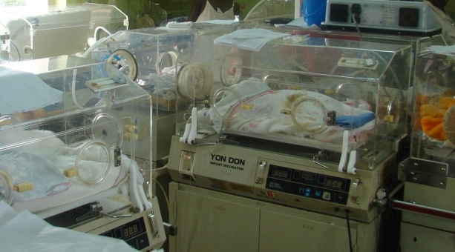
Market and Commercialization Potential
Market Strategies
Expected sales:
In Uganda we hope to ship 1500 units to the hospitals and clinics. We will charge $50/unit.
No current incubators targeted toward developing nations are priced low enough to garner widespread adoption.
Target
Uganda
Other developing countries
Customers
Ministry of Health
NGOs
Donors
Consumers
National and Regional Hospitals
Sub-district hospitals
Other rural healthcare facilities
Neonates
P: 212.854.6196 F: 212.854.8725
351 Engineering Terrace
1210 Amsterdam Ave
New York, NY 10027
|
Incuvive.weebly.com
Notes:
We arrived at this number based on number of hospital and clinic in uganda
Our Fixed Costs total $98,000 (does not seem to be what Aaron wants after his most recent email too detailed)
Our Variable Costs total $ 285,500 (material cost + wages + other variable costs from BP)
All revenue from devices sold used to offset unpaid expenses and build more units.
Ugandan hospitals are using donated blankets and donated incubators I don’t our device will save them money only improve the standard of care. Also we are selling our device at a loss so we are not generating profit with each unit sold. Profits will come from keeping our costs lower than the amount we bring in with donations.

Slide 16
Future Business Plans
Phase I: Clinical Testing (2012-2013)
Obtain IRB approval for testing.
Phase II: Final Product Development and International Device Approval (2013-2015)
Incorporate testing data into development of Final Prototype
Phase III: Reimbursement and Market Availability (2015-2021)
Continue to request NGO funds so our device can be distributed to Uganda’s hospitals and clinics.
Phase IV: Expansion (2016-2021)
Utilize profits from initial device to fund research and development of new devices.
Provide two initial test units to Mulago Hospital for in-field data collection.
Begin selling and distributing our device to additional developing nations worldwide.
Apply for International Device Approval.

Slide 17
Future Plans
Gather information
Generate multiple solutions
Analyze and select a solution
Test and implement solution
Define the problem
Optimization
Feedback algorithm
Thinner tubing bed material for optimal heat exchange
Fold-over component
Testing
New feedback algorithm to reach and maintain saline bag at 36.5-37.5 ⁰C
Ability to reach and maintain saline bag at 36.5-37.5 ⁰C with the addition of insulation materials
Ability of fold-over component and mat to reach and maintain saline bag at 36.5-37.5 ⁰C
Refinement of Frankenstein prototype
Control via monitor
Maximize versatility of heating unit
Battery power
Simple directions manual
Engineering Design Process
Notes:
We will begin the next cycle of the engineering process in the latter half of this semester.
CLICK: Our main objectives are to refine our first prototype by adding a fold-over heating component to our system. This can act as an additional heating source or the additional space can be used to warm another infant simultaneously. We will also have our feedback settings controlled via a monitor, and maximize the versatility of the heating unit such that it can be used with any type of generic water reservoir. Additionally, we are hoping to have a heating unit such that it could feed into more than one mat heating system to heat multiple infants. As an additional fail-safe in case of power outages, we hope our system can be battery powered as well. Lastly, we will make a simple directions manual for our end-users.
CLICK: We also will optimize our feedback algorithm by finding a better temperature window where the heating unit turns on and off as well as incorporate any additional safety features. If we decide to stick with this tube mat design, we will have to find thinner tubing material such for optimal heating exchange
CLICK: To test our future prototypes, we will have to see how effective an optimized and refined feedback algorithm heats up and maintains a saline bag at 36.5-37.5 ⁰C
We also need to test our systems ability to reach and maintain the saline bag at 37 ⁰C with addition of insulations.
Lastly, we hope to see how effective our fold-over component and mat heats and maintains a saline bag at 36.5-37.5 ⁰C.
plans for prototype refinement, optimization, testing & validation

Slide 18
Acknowledgments
Instructors
Aaron Kyle, Ph.D. , Biomedical Engineering Dept., Columbia University
Elizabeth Hillman, Ph.D. , Biomedical Engineering Dept., Columbia University
Keith Yeager
Sarah De Leo (TA)
David Jangraw (TA)
Advisers and Consultants
Lance Kam, Ph.D., Biomedical Engineering Dept., Columbia University
Margaret Nakakeeto-Kijjambu, MD, Mulago Hospital
Richard Polin, MD, CUMC Pediatrics
Rakesh Sahni, MD, CUMC Pediatrics
Helen Towers, MD, CUMC Pediatrics
Yvonne Vaucher, MD, UCSD
David Vallancourt, Ph.D., Electrical Engineering Dept., Columbia University
incuvive.weebly.com

